Slide 1
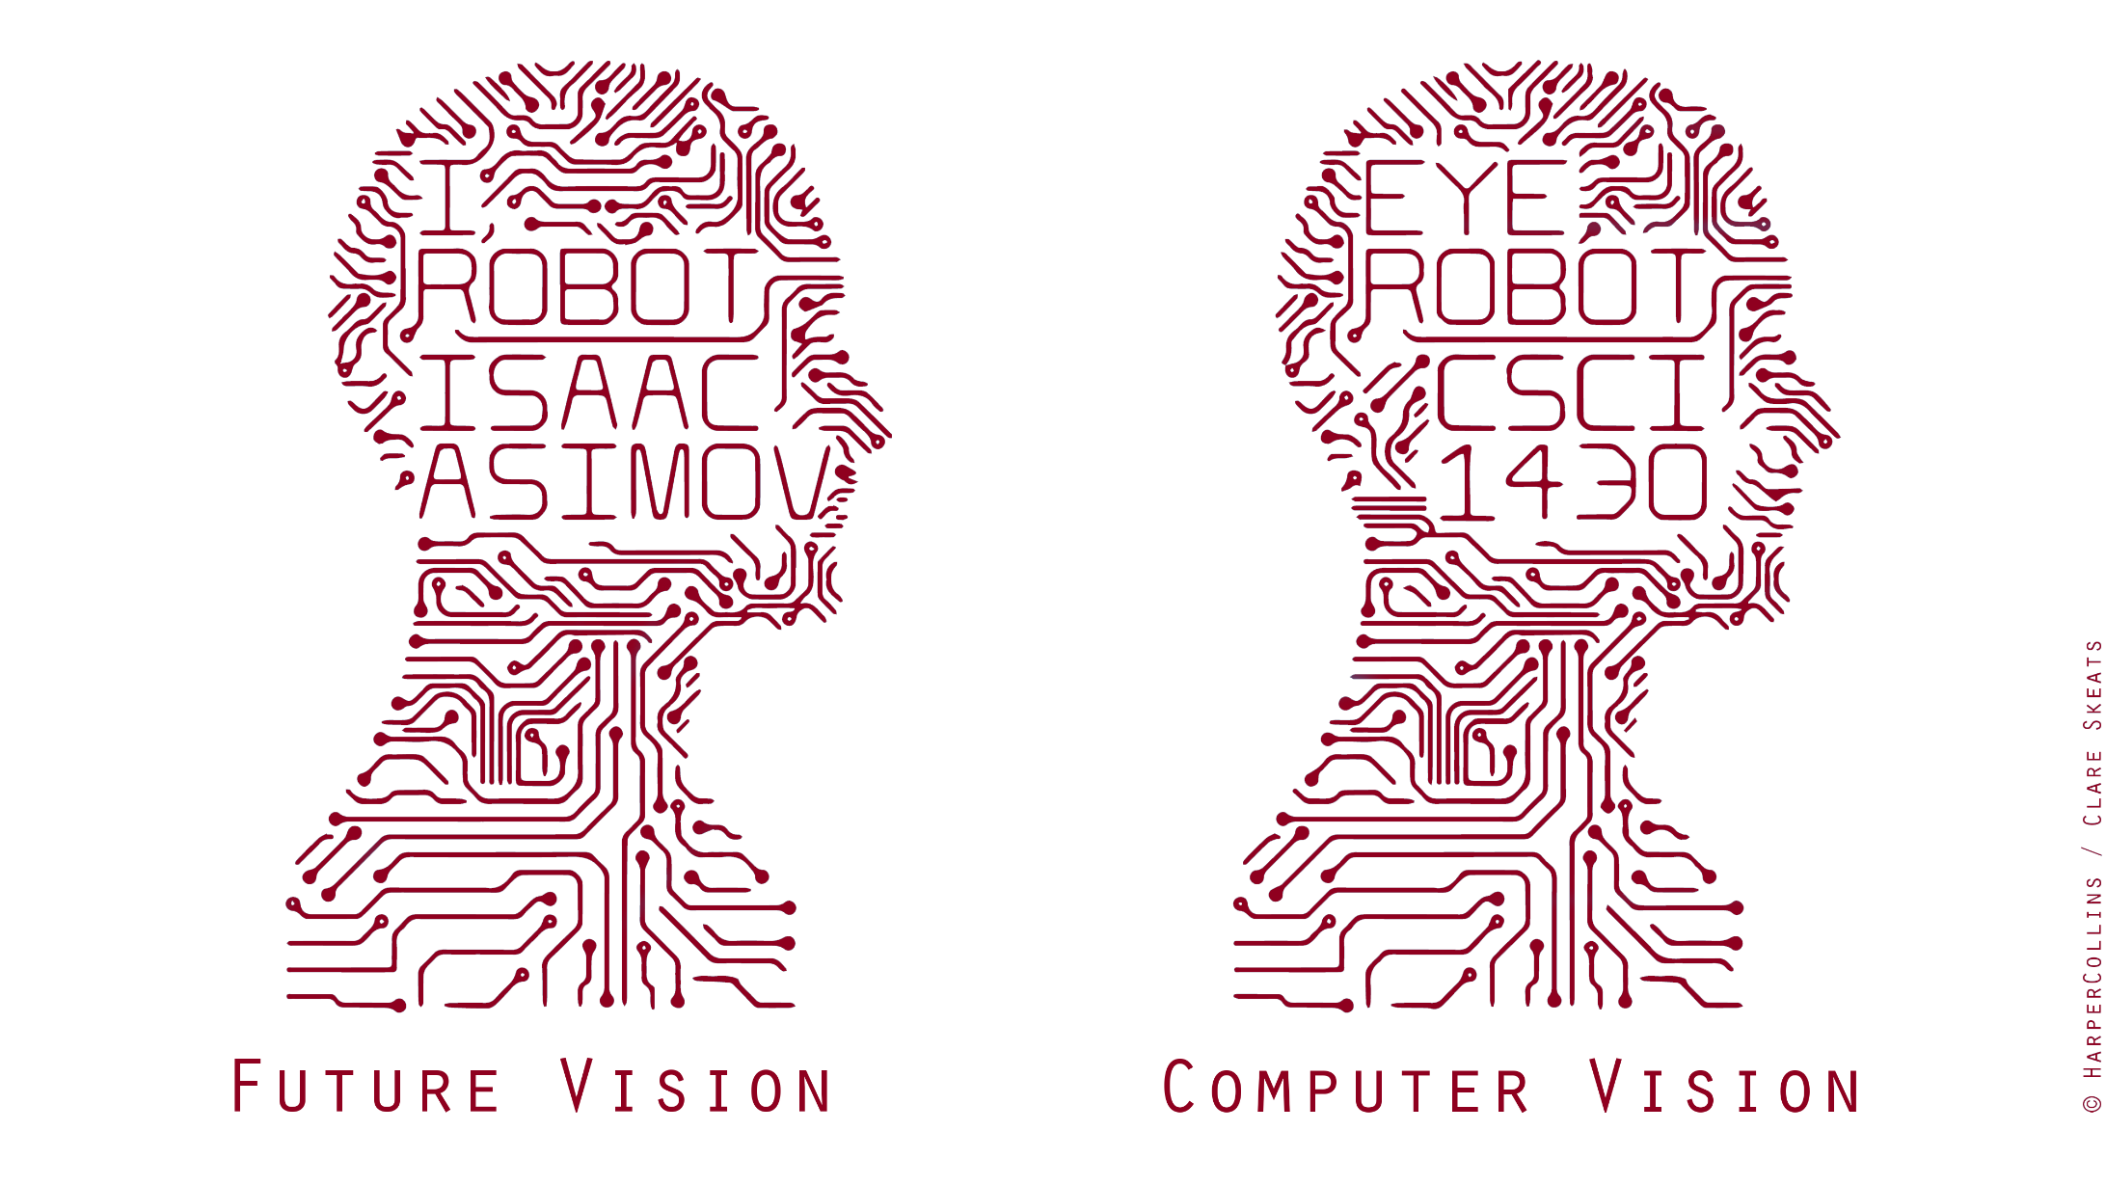
Prismia.Chat https://tinyurl.com/y26ragof
Notes:
https://prismia.chat/projects/ccaebf77-a313-4f85-a7ee-4416aaaf014d/join

Slide 2
Next Classes
Spatial frequency
Fourier transform and frequency domain
Frequency view of filtering
Hybrid images
Sampling
Slide: Hoiem

Slide 3
Overview of today’s lecture
Image downsampling.
Aliasing.
Gaussian image pyramid.
Laplacian image pyramid.
Fourier series.
Frequency domain.
Fourier transform.
Frequency-domain filtering.
Revisiting sampling.

Slide 4
Slide credits
Most of these slides were adapted directly from:
Kris Kitani (15-463, Fall 2016).
Some slides were inspired or taken from:
Fredo Durand (MIT).
Bernd Girod (Stanford University).
James Hays (Georgia Tech).
Steve Marschner (Cornell University).
Steve Seitz (University of Washington).

Slide 5
Image downsampling

Slide 6


Why does a lower resolution image still make sense to us? What information do we lose?
Image: http://www.flickr.com/photos/igorms/136916757/
Slide: Hoiem

Slide 7
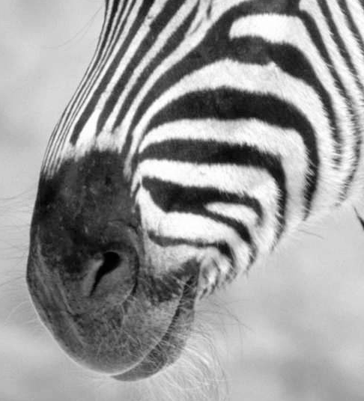
Making lower resolution images: Subsampling by a factor of 2
Throw away every other row and column to create a 1/2 size image

Slide 8
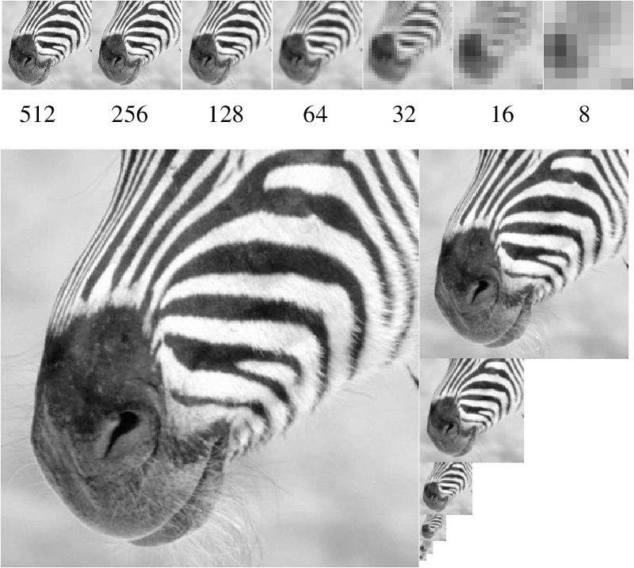
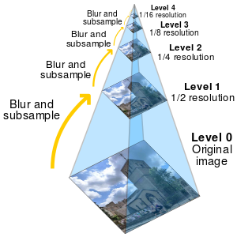
Figure from David Forsyth
A ‘bar’ in the big images is a hair on the zebra’s nose; in smaller images, a stripe; in the smallest, the animal’s nose
Image pyramid

Slide 9
Algorithm for downsampling by factor of 2
Start with image of w x h
Sample every other pixel
im_small = image[ ::2, ::2 ]
To build a pyramid, repeat Steps 1 & 2 until im_small is 1 pixel large.
Numpy syntax:
::2 -> start at 0, end at ‘end’, increase every 2, until the end.
e.g., 0,2,4,6,…,w
(if w is not even, then this goes to w-1)
Hays

Slide 10
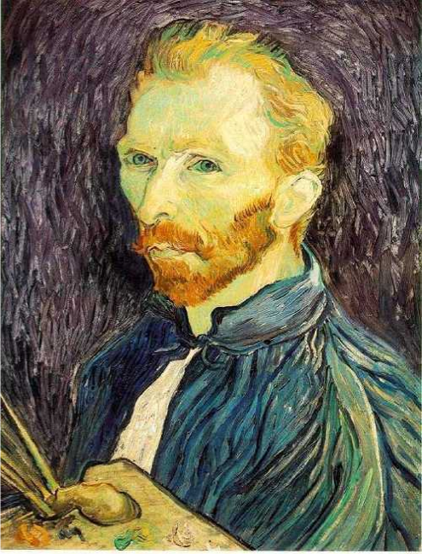
This image is too big to fit on the screen.
How would you reduce it to half its size?

Slide 11
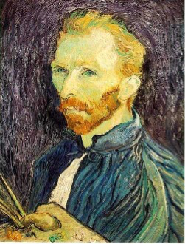
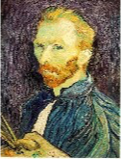
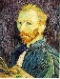
Naïve image downsampling
Throw away half the rows and columns
delete even rows
delete even columns
delete even rows
delete even columns
1/8
1/4
1/2
What is the problem with this approach?

Slide 12
Naïve image downsampling
1/2
1/4 (2x zoom)
1/8 (4x zoom)
What is the 1/8 image so pixelated (and do you know what this effect is called)?

Slide 13
Aliasing

Slide 14
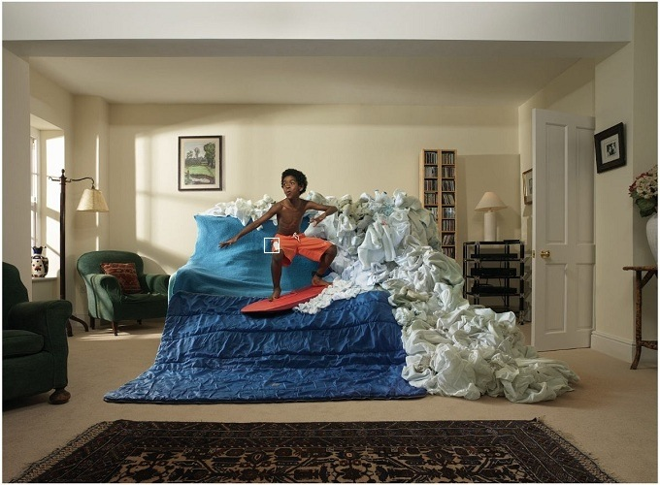
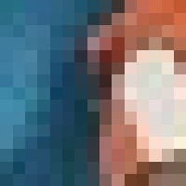

Reminder
Images are a discrete, or sampled, representation of a continuous world

Slide 15
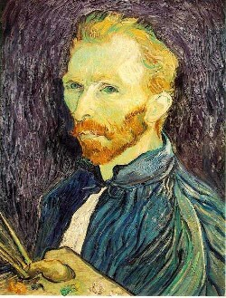


Image sub-sampling
1/8
1/4
Throw away every other row and column to create a 1/2 size image.
Steve Seitz

Slide 16

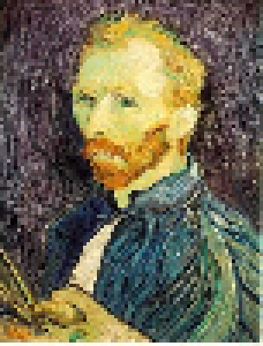
Subsampling without filtering
1/2
1/4 (2x subsample)
1/8 (4x subsample)
Steve Seitz

Slide 17
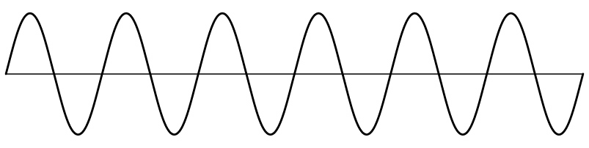
Sampling
Very simple example: a sine wave
How would you discretize this signal?

Slide 18
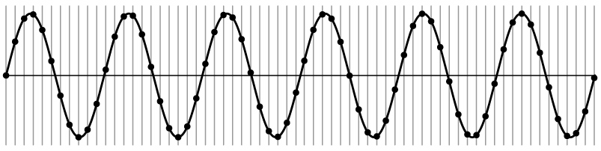
Sampling
Very simple example: a sine wave

Slide 19
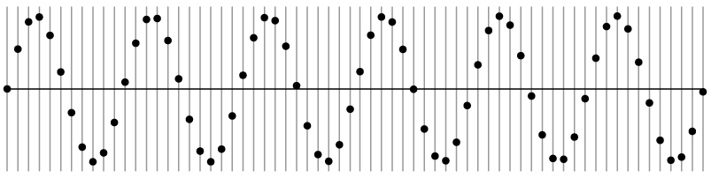
Sampling
Very simple example: a sine wave
How many samples should I take?
Can I take as many samples as I want?

Slide 20
Sampling
Very simple example: a sine wave
How many samples should I take?
Can I take as few samples as I want?

Slide 21
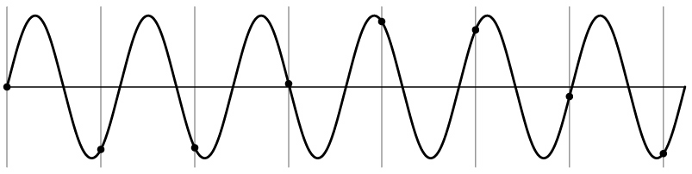
Undersampling
Very simple example: a sine wave
Unsurprising effect: information is lost.

Slide 22
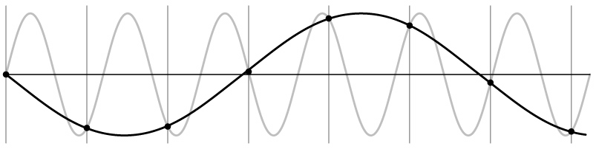
Undersampling
Very simple example: a sine wave
Unsurprising effect: information is lost.
Surprising effect: can confuse the signal with one of lower frequency.

Slide 23
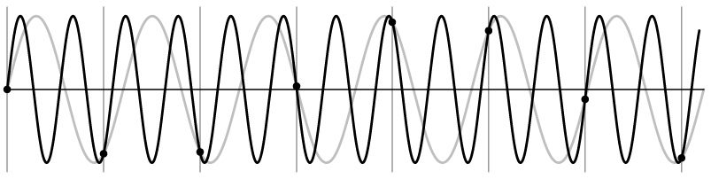
Undersampling
Very simple example: a sine wave
Unsurprising effect: information is lost.
Surprising effect: can confuse the signal with one of lower frequency.
Note: we could always confuse the signal with one of higher frequency.

Slide 24
Aliasing
Fancy term for: Undersampling can disguise a signal as one of a lower frequency
Unsurprising effect: information is lost.
Surprising effect: can confuse the signal with one of lower frequency.
Note: we could always confuse the signal with one of higher frequency.

Slide 25
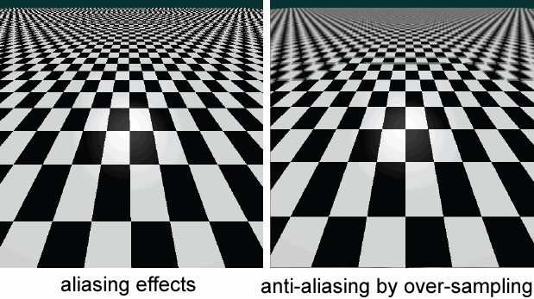
Aliasing in textures

Slide 26
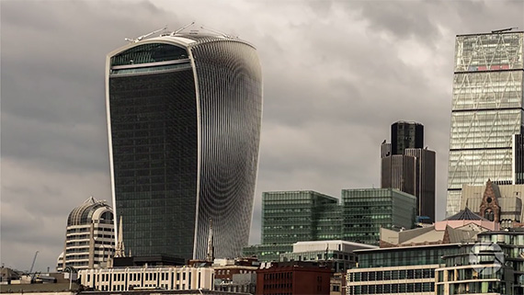
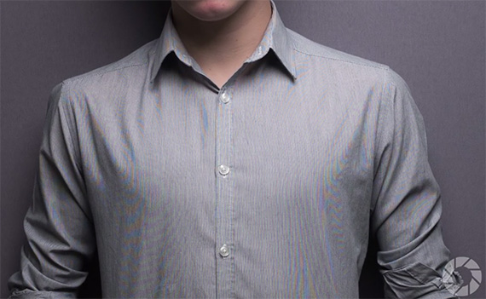
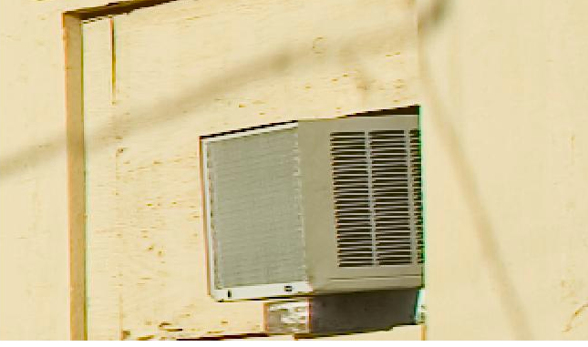
Aliasing in photographs
This is also known as “moire”

Slide 27
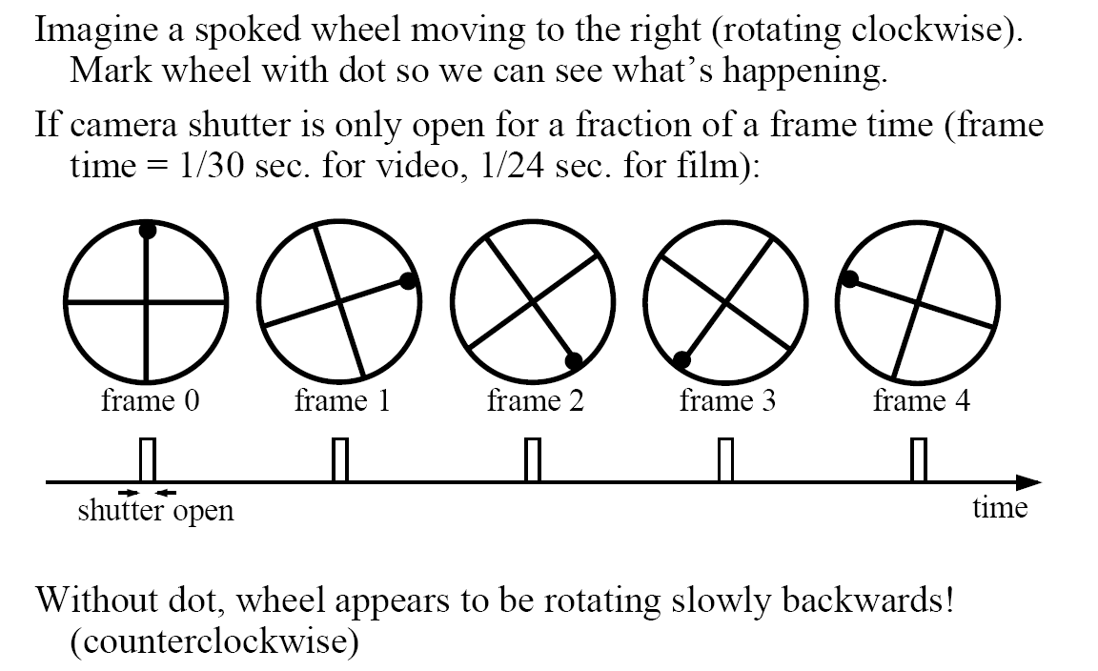
Temporal aliasing

Slide 28
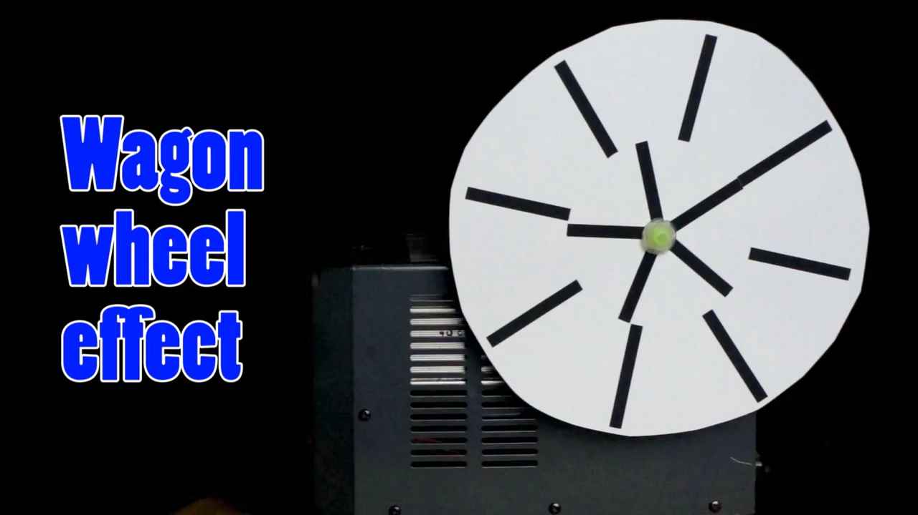
Temporal aliasing

Slide 29
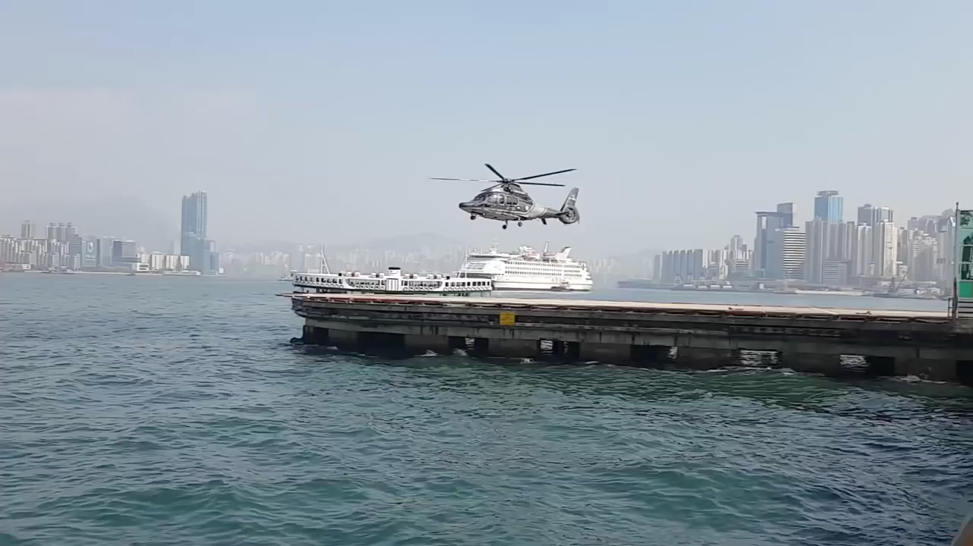
Temporal aliasing

Slide 30
Sampling and aliasing

Slide 31
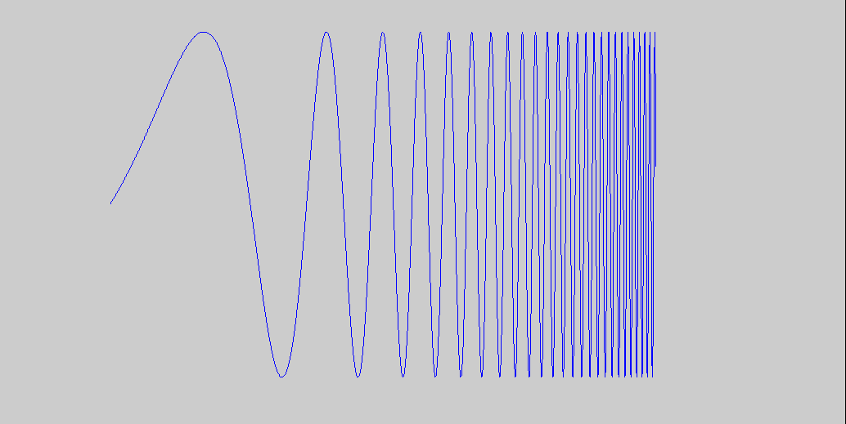
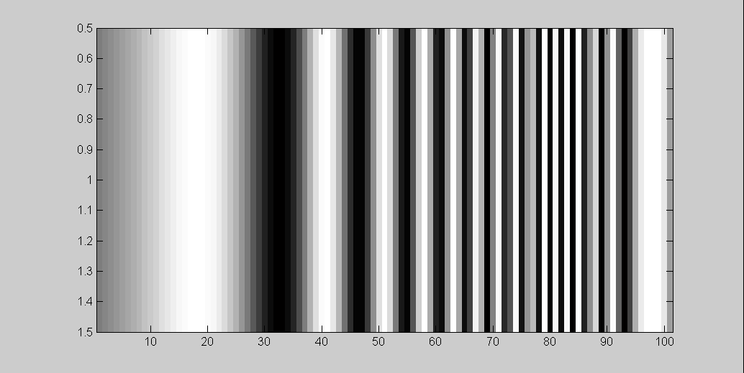
What’s happening?
Aliasing!
Not enough samples
Input signal:
Plot as image:
x = 0:.05:5; plt.imshow(sin((2.^x).*x))
Aliasing:
When two signals become indistinguishable from one another due to sampling.
They are ‘aliases’ of one another.

Slide 32
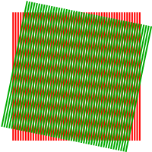
Aliasing problem
Sub-sampling may be dangerous….
Characteristic errors may appear:
“car wheels rolling the wrong way in movies”
“checkerboards disintegrate in graphics”
“striped shirts look funny on color television”
Moiré patterns
Source: D. Forsyth; Wikipedia

Slide 33
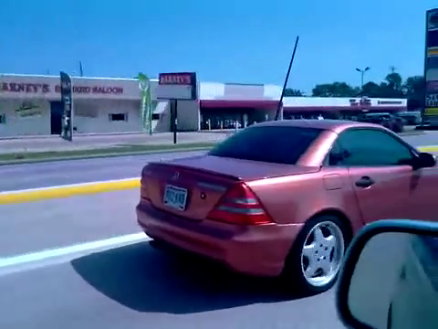
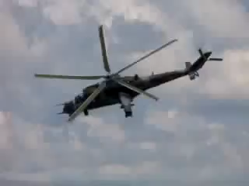
Temporal Aliasing in Videos
[YouTube; JoinBuzzirk; phrancque]
Notes:
https://www.youtube.com/watch?v=Y1yHMy0-4TM
https://www.youtube.com/watch?v=jQDjJRYmeWg

Slide 34
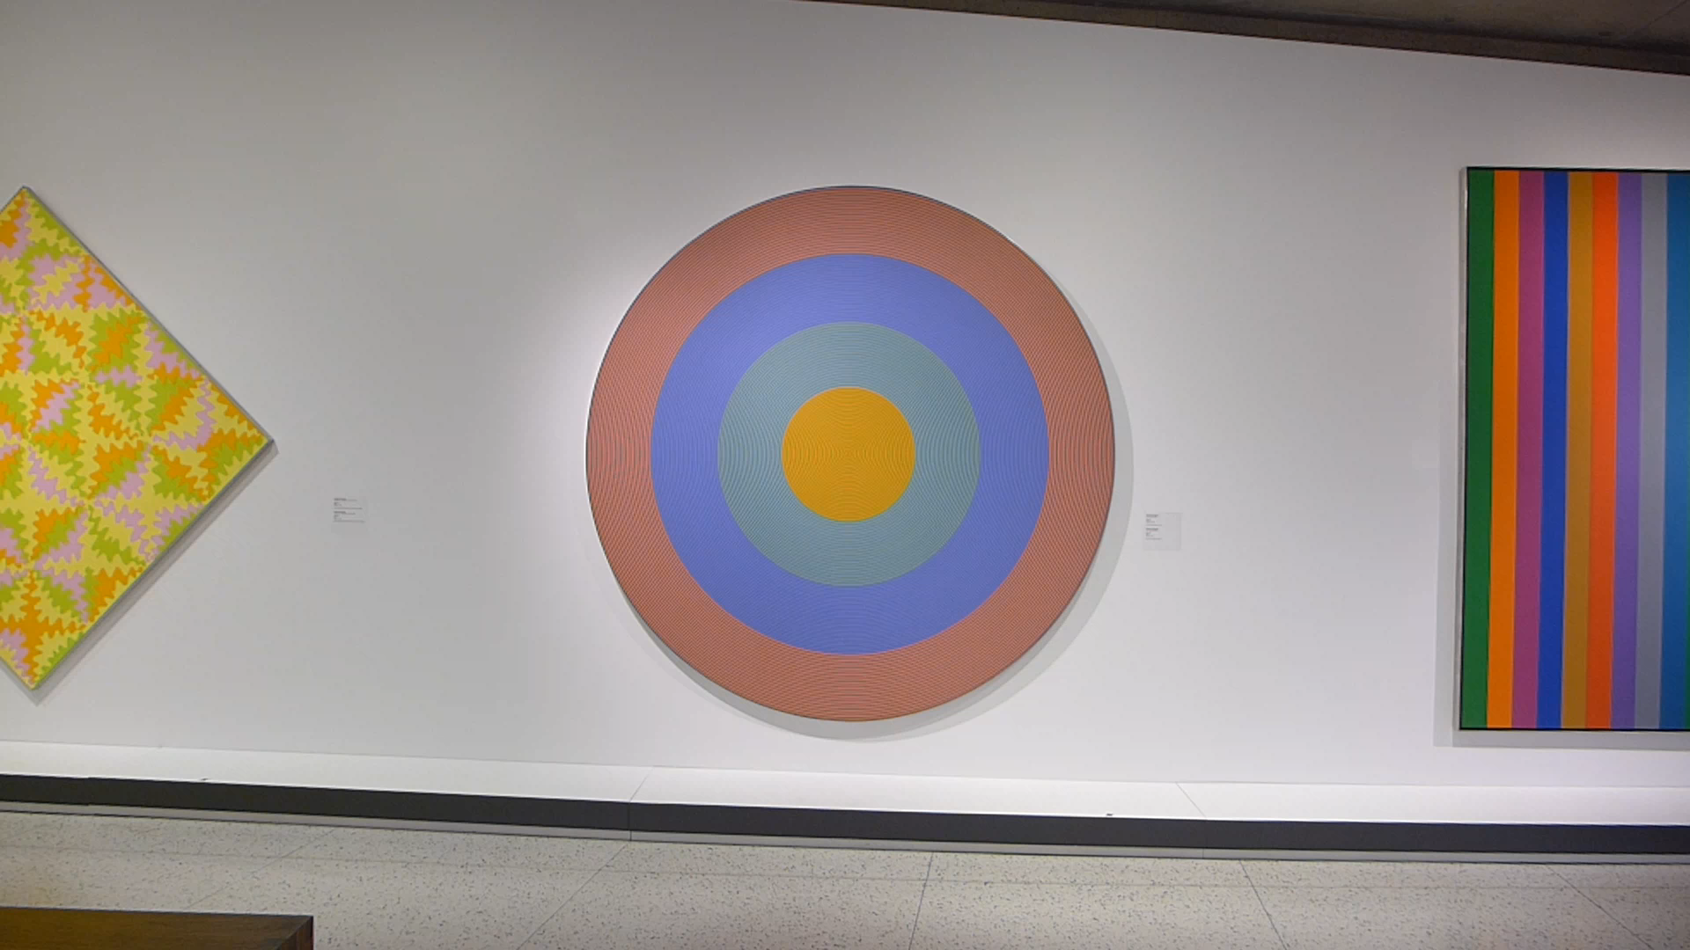
Aliasing and Moiré patterns
Gong 96, 1932, Claude Tousignant, Musée des Beaux-Arts de Montréal

Slide 35
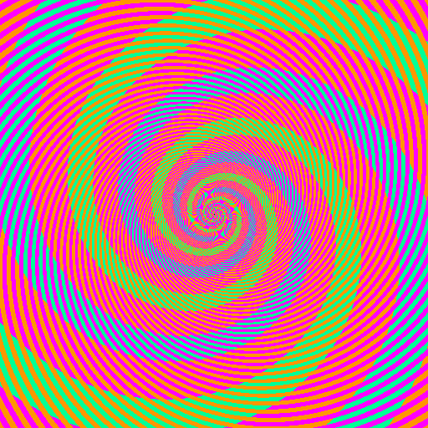

Slide 36
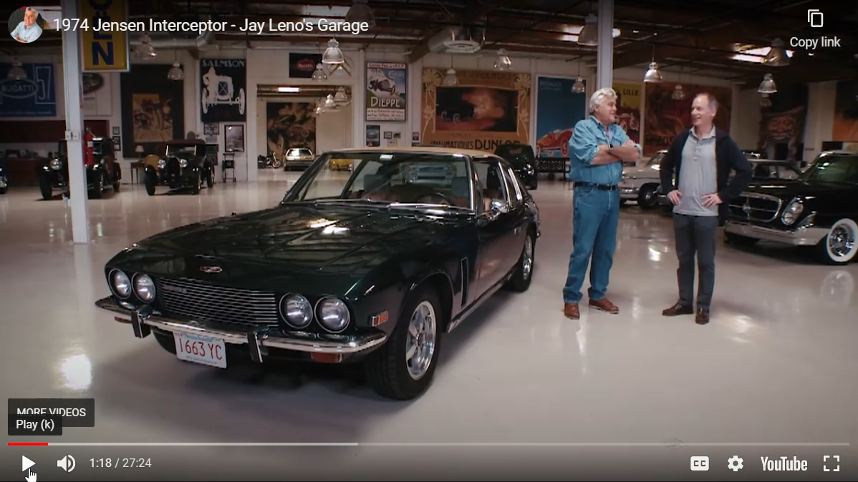
Severe Moiré pattern
Notes:
https://youtu.be/KGVcJrEJW7E

Slide 37
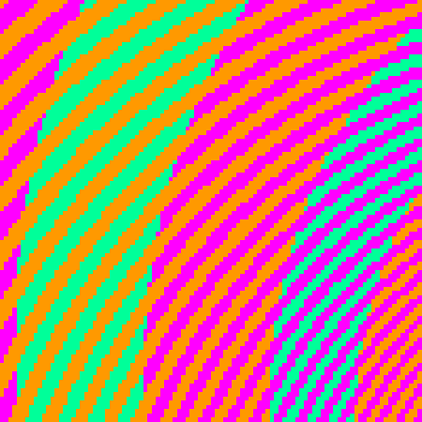
The blue and green colors are actually the same
http://blogs.discovermagazine.com/badastronomy/2009/06/24/the-blue-and-the-green/

Slide 38
Nyquist-Shannon Sampling Theorem
When sampling a signal at discrete intervals, the sampling frequency must be ≥ 2 × f_{max}
f_{max} = max frequency of the input signal
This allows us to reconstruct the original perfectly from the sampled version
v
v
v
good
bad

Slide 39
Anti-aliasing
How would you deal with aliasing?

Slide 40
Anti-aliasing
How would you deal with aliasing?
Approach 1: Oversample the signal

Slide 41
Anti-aliasing in textures
aliasing artifacts
anti-aliasing by oversampling

Slide 42
Anti-aliasing
How would you deal with aliasing?
Approach 1: Oversample the signal
Approach 2: Smooth the signal
Remove some of the detail effects that cause aliasing.
Lose information, but better than aliasing artifacts.
How would you smooth a signal?

Slide 43

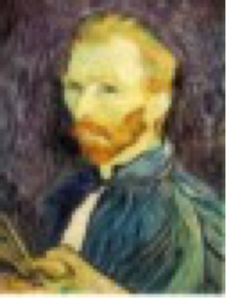
Better image downsampling
Apply a smoothing filter first, then throw away half the rows and columns
Gaussian filter
delete even rows
delete even columns
Gaussian filter
delete even rows
delete even columns
1/8
1/4
1/2

Slide 44
Better image downsampling
1/2
1/4 (2x zoom)
1/8 (4x zoom)

Slide 45
Naïve image downsampling
1/2
1/4 (2x zoom)
1/8 (4x zoom)

Slide 46
Anti-aliasing
Question 1: How much smoothing do I need to do to avoid aliasing?
Question 2: How many samples do I need to take to avoid aliasing?
Answer to both: Enough to reach the Nyquist limit.

Slide 47
How to fix aliasing?
Solutions?

Slide 48
Better sensors
Solutions:
Sample more often

Slide 49
Anti-aliasing
Solutions:
Sample more often
Remove all frequencies that are greater than half the new sampling frequency
Will lose information
But it’s better than aliasing
How?
Hays

Slide 50
Low-pass and high-pass filtering
Remove high frequencies with a low pass filter
A blur filter!
Could also be called a ‘high cut’ filter (but nobody does)

Slide 51
Low-pass and high-pass filtering
Remove high frequencies with a low pass filter
A blur filter!
Could also be called a ‘high cut’ filter (but nobody does)
Counterpart: high pass filter
Only keeps the high frequencies
Edge detection (Sobel) is an example high pass filter
Related: band pass / band stop (or notch) filter
Only affect specific frequencies
How could we construct one with linear filters?

Slide 52
Anti-aliasing
Forsyth and Ponce 2002

Slide 53
Algorithm for downsampling by factor of 2
Start with image(h, w)
Apply low-pass filter
im_blur = imfilter( image, fspecial(‘gaussian’, 7, 1) )
Sample every other pixel
im_small = im_blur( 1:2:end, 1:2:end );
Hays

Slide 54
Subsampling without filtering
1/2
1/4 (2x subsample)
1/8 (4x subsample)
Steve Seitz

Slide 55



Subsampling with Gaussian pre-filtering
Steve Seitz
Gaussian 1/2
G 1/4
G 1/8
Gaussian Pyramid [Burt and Adelson, 1983]

Slide 56
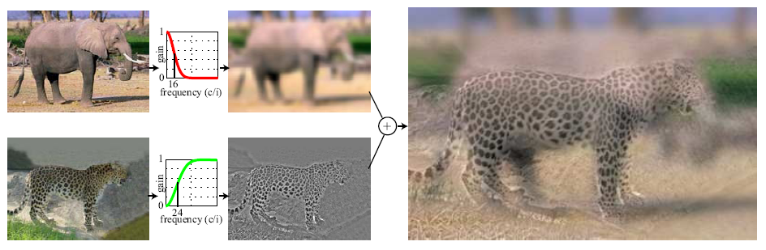
Hybrid Images
Hays
A. Oliva, A. Torralba, P.G. Schyns, “Hybrid Images,” SIGGRAPH 2006

Slide 57
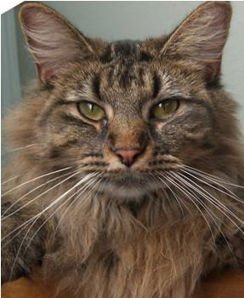
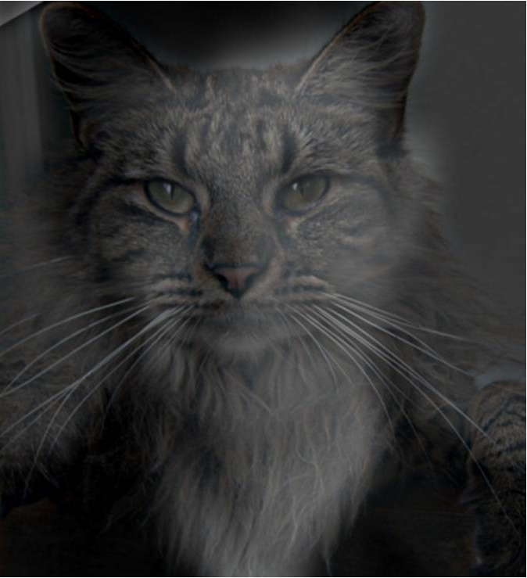
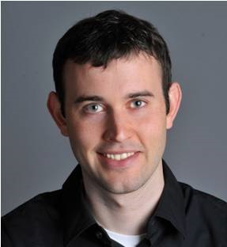
Why do we get different, distance-dependent interpretations of hybrid images?
?
Slide: Hoiem

Slide 58
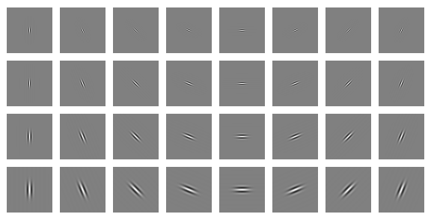
Clues from Human Perception
Early visual processing in human perception filters for orientations and scales of frequency.
Related to Gabor filters: sinusoids convolved with Gaussians
Notes:
Early Visual Processing: Multi-scale edge and blob filters
https://en.wikipedia.org/wiki/Gabor_filter

Slide 59
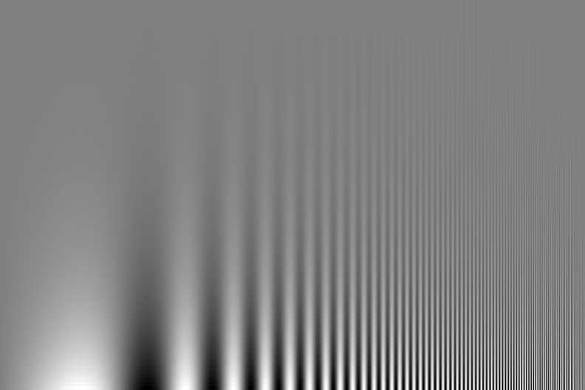
Campbell-Robson contrast sensitivity curve
Perceptual cues in the mid-high frequencies dominate perception.
Contrast decrease (log)
Frequency increase (log)
Notes:
Ask students to look at the image and think about where the line of constant response is -

Slide 60
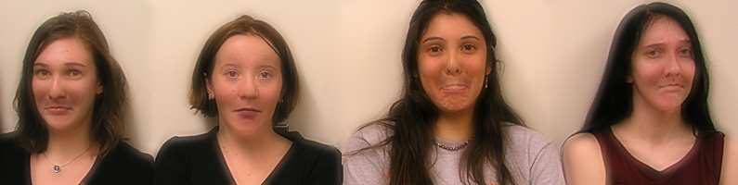

Application: Hybrid Images
When we see an image from far away, we are effectively subsampling it!
A. Oliva, A. Torralba, P.G. Schyns, SIGGRAPH 2006

Slide 61
Gaussian image pyramid

Slide 62
Gaussian image pyramid
The name of this sequence of subsampled images

Slide 63
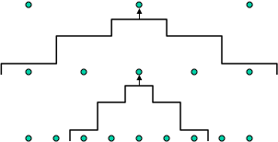
Constructing a Gaussian pyramid
Algorithm
sample
repeat:
filter
filter
sample
subsample
until min resolution reached
filter
sample
Question: How much bigger than the original image is the whole pyramid?

Slide 64
Constructing a Gaussian pyramid
Algorithm
sample
repeat:
filter
filter
sample
subsample
until min resolution reached
filter
sample
Question: How much bigger than the original image is the whole pyramid?
Answer: Just 4/3 times the size of the original image! (How did I come up with this number?)

Slide 65
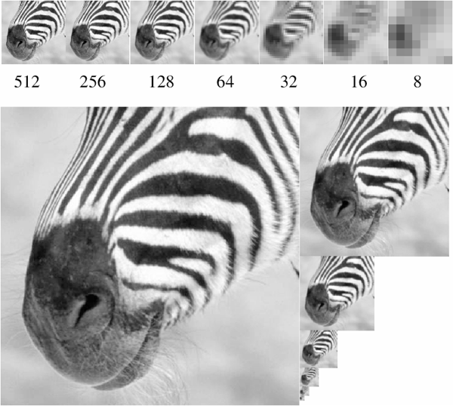
Some properties of the Gaussian pyramid
What happens to the details of the image?

Slide 66
Some properties of the Gaussian pyramid
What happens to the details of the image?
They get smoothed out as we move to higher levels.
What is preserved at the higher levels?

Slide 67
Some properties of the Gaussian pyramid
What happens to the details of the image?
They get smoothed out as we move to higher levels.
What is preserved at the higher levels?
Mostly large uniform regions in the original image.
How would you reconstruct the original image from the image at the upper level?

Slide 68
Some properties of the Gaussian pyramid
What happens to the details of the image?
They get smoothed out as we move to higher levels.
What is preserved at the higher levels?
Mostly large uniform regions in the original image.
How would you reconstruct the original image from the image at the upper level?
That’s not possible.

Slide 69
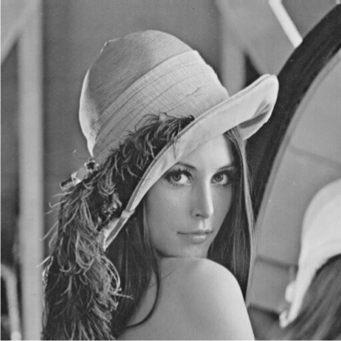
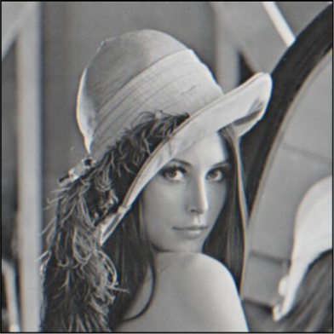
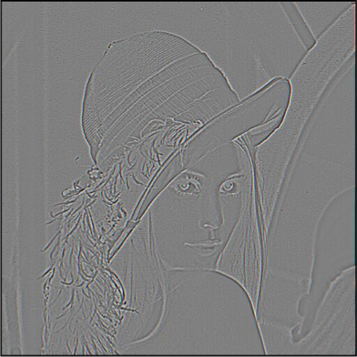
Blurring is lossy
-
=
level 0
level 1 (before downsampling)
residual
What does the residual look like?

Slide 70
Blurring is lossy
-
=
level 0
level 1 (before downsampling)
residual
Can we make a pyramid that is lossless?

Slide 71
Laplacian image pyramid

Slide 72
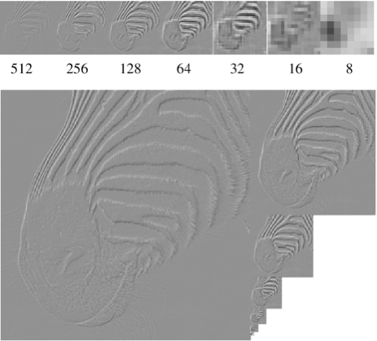
Laplacian image pyramid
At each level, retain the residuals instead of the blurred images themselves.
Can we reconstruct the original image using the pyramid?

Slide 73
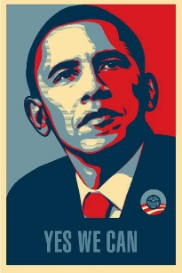
Laplacian image pyramid
At each level, retain the residuals instead of the blurred images themselves.
Can we reconstruct the original image using the pyramid?
Yes we can!
What do we need to store to be able to reconstruct the original image?

Slide 74
Let’s start by looking at just one level
=
+
level 0
level 1 (upsampled)
residual
Does this mean we need to store both residuals and the blurred copies of the original?

Slide 75
Constructing a Laplacian pyramid
Algorithm
repeat:
filter
compute residual
subsample
until min resolution reached

Slide 76
Constructing a Laplacian pyramid
What is this part?
Algorithm
repeat:
filter
compute residual
subsample
until min resolution reached

Slide 77
Constructing a Laplacian pyramid
It’s a Gaussian pyramid.
Algorithm
repeat:
filter
compute residual
subsample
until min resolution reached

Slide 78
What do we need to construct the original image?

Slide 79
What do we need to construct the original image?
(1) residuals

Slide 80
What do we need to construct the original image?
(2) smallest image
(1) residuals

Slide 81
Reconstructing the original image
Algorithm
repeat:
upsample
sum with residual
until orig resolution reached

Slide 82
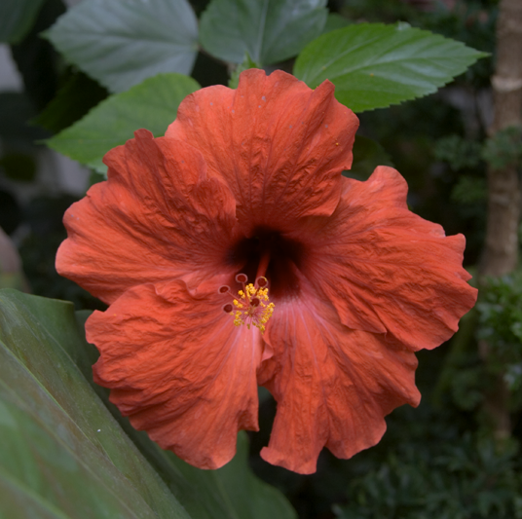






Gaussian vs Laplacian Pyramid
Shown in opposite order for space.
Which one takes
more space to store?

Slide 83
Why is it called a Laplacian pyramid?

Slide 84

Reminder: Laplacian of Gaussian (LoG) filter
As with derivative, we can combine Laplace filtering with Gaussian filtering
input
Laplacian of Gaussian
output
“zero crossings” at edges

Slide 85



Why is it called a Laplacian pyramid?
-
=
-
unit
Gaussian
Laplacian
Difference of Gaussians approximates the Laplacian

Slide 86
Why Reagan?

Slide 87
Why Reagan?
Ronald Reagan was President when the Laplacian pyramid was invented
The Laplacian Pyramid as a Compact Image Code (1983)
Peter J. Burt , Edward H. Adelson

Slide 88

Still used extensively

Slide 89



Still used extensively
input image
foreground details enhanced, background details reduced
user-provided mask

Slide 90






Other types of pyramids
Steerable pyramid: At each level keep multiple versions, one for each direction.
Wavelets: Huge area in image processing (see 18-793).

Slide 91




What are image pyramids used for?
image compression
multi-scale
texture mapping
image blending
focal stack compositing
denoising
multi-scale detection
multi-scale registration

